Slide 1
Lab 3
ITEC618 Labs
Programming Concepts
Dr. Farshid Keivanian

Slide 2
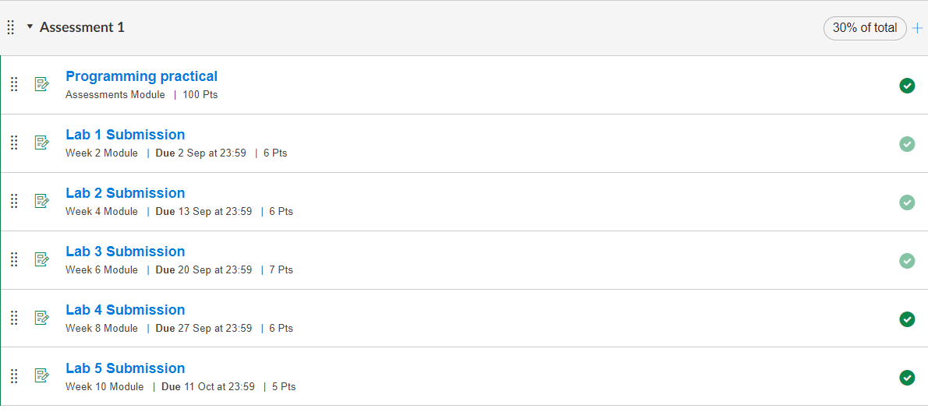

Slide 3
Task completion (3%)
6.1 (0.5%) (Countdown Simulator) Write a program that prompts the user to enter the number of seconds, displays a message at every second, and terminates when the time expires.

Slide 4
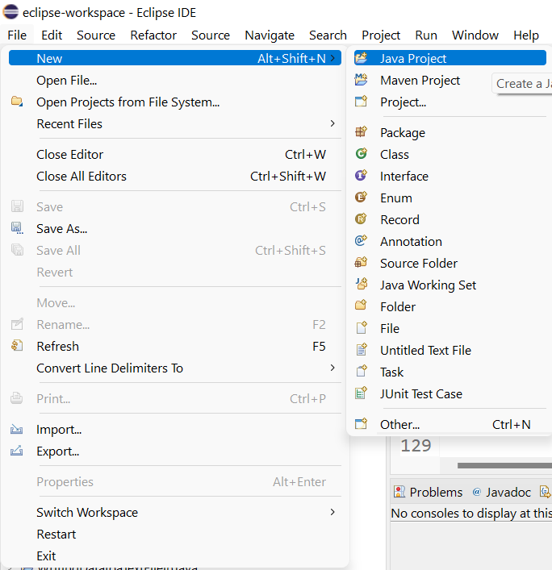
Task completion (3%)

Slide 5
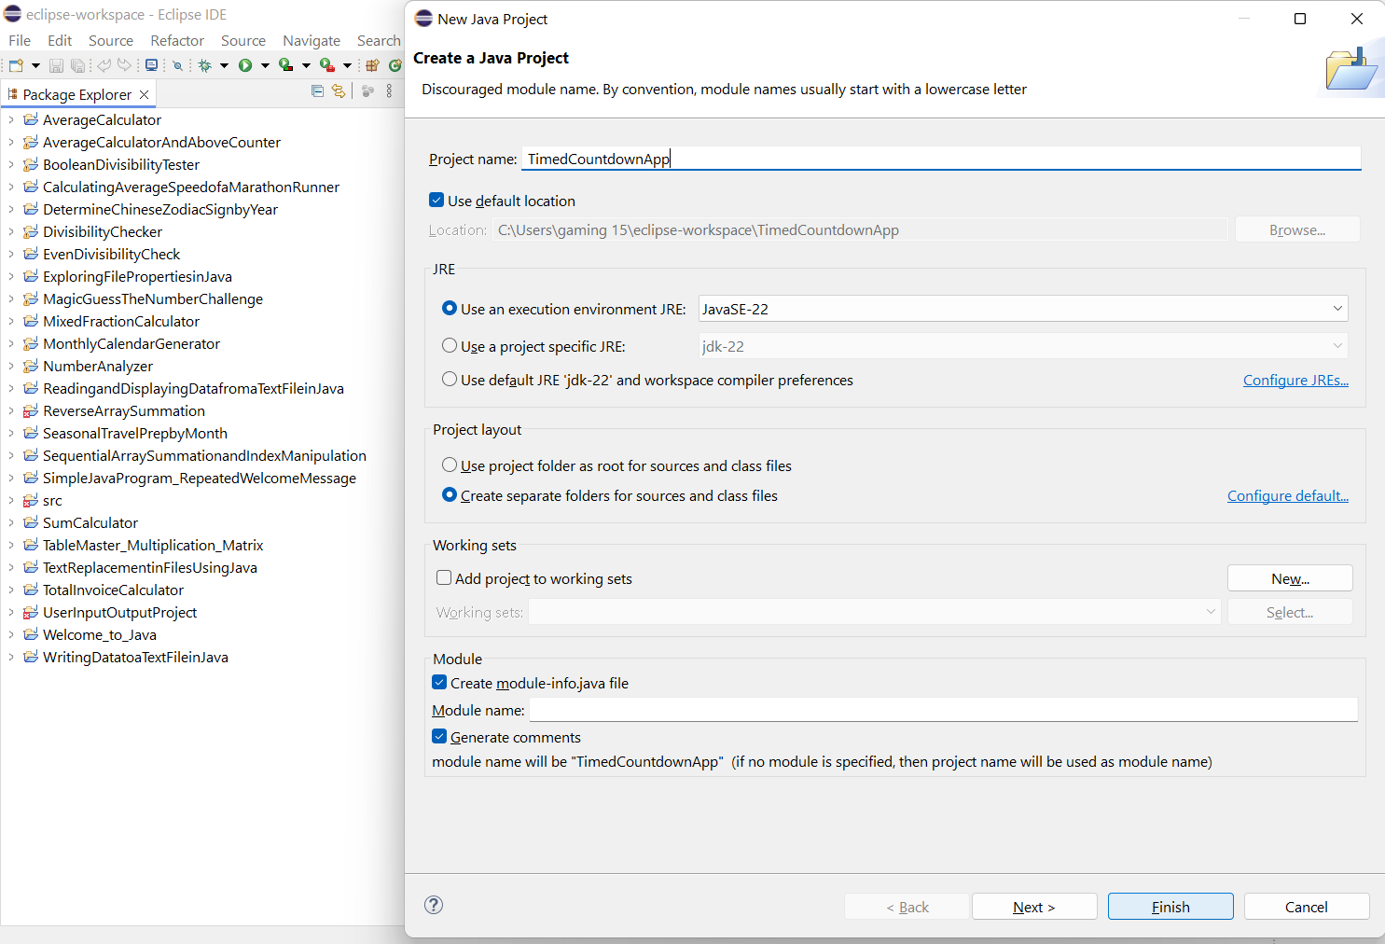
Task completion (3%)

Slide 6
Task completion (3%)

Slide 7
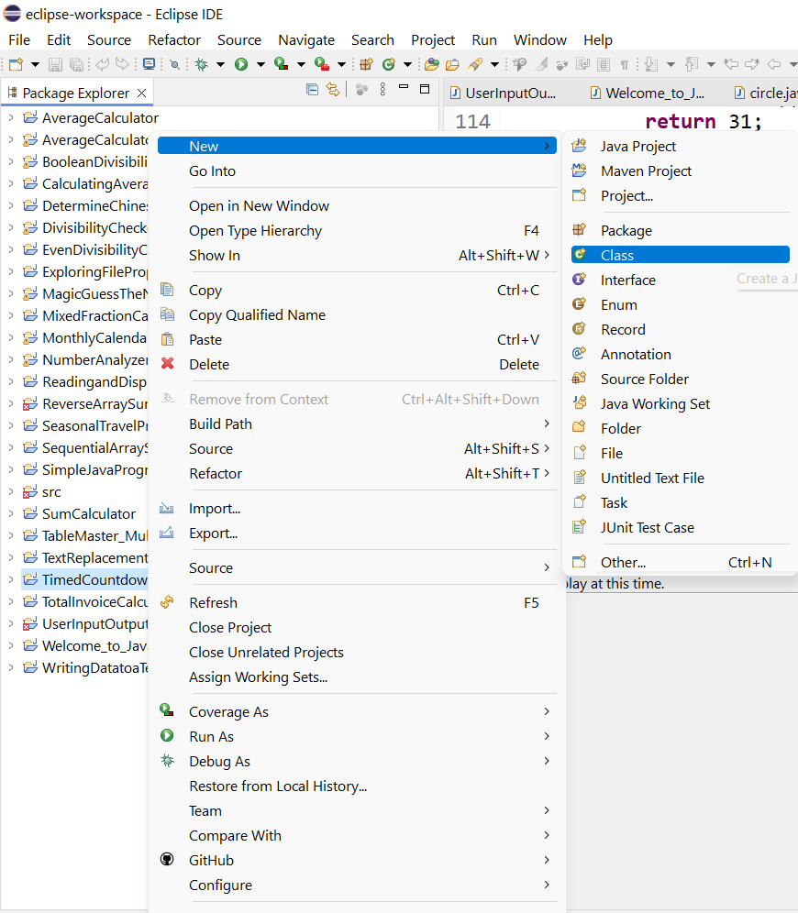
Task completion (3%)

Slide 8
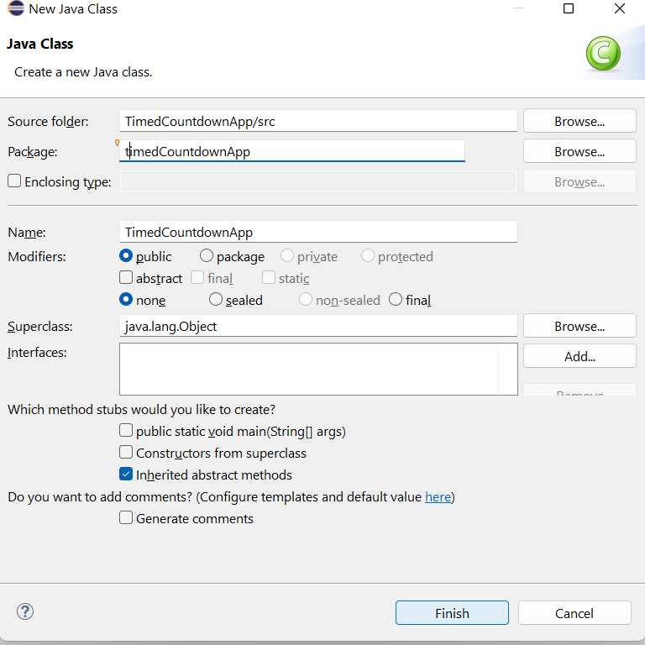
Task completion (3%)

Slide 9
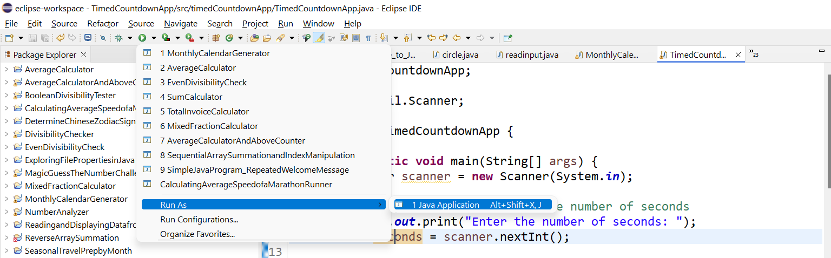
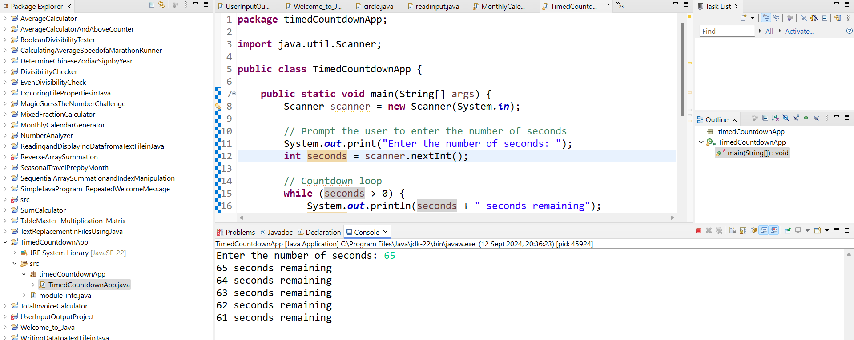

Slide 10
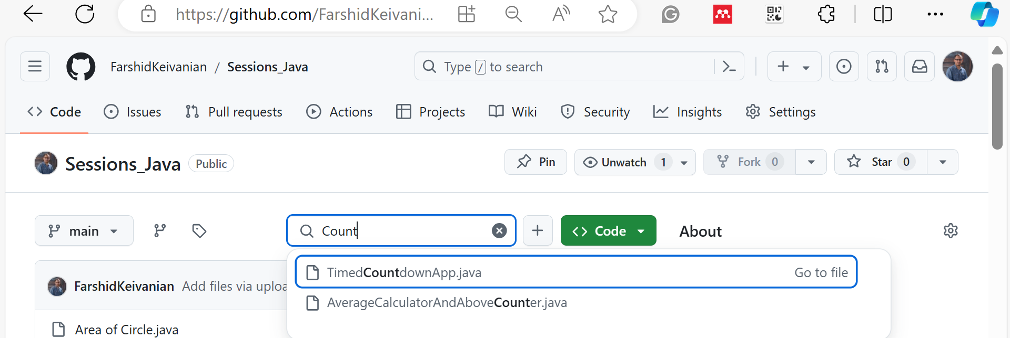

Slide 11
package timedCountdownApp;
import java.util.Scanner;
public class TimedCountdownApp {
public static void main(String[] args) {
Scanner scanner = new Scanner(System.in);
// Prompt the user to enter the number of seconds
System.out.print("Enter the number of seconds: ");
int seconds = scanner.nextInt();
// Countdown loop
while (seconds > 0) {
System.out.println(seconds + " seconds remaining");
seconds--;
// Pause for 1 second
try {
Thread.sleep(1000);
} catch (InterruptedException e) {
System.out.println("Countdown was interrupted.");
}
}
// Final message after countdown ends
System.out.println("Stopped");
}
}
Scanner: Used to get input from the user.
Countdown loop: The while loop runs until the countdown reaches zero.
Thread.sleep(1000): This pauses the execution for 1000 milliseconds (1 second) between each iteration of the loop to simulate the countdown.
Final message: Once the countdown is complete, it prints "Stopped."

Slide 12
package timedCountdownApp;
import java.util.Scanner;
public class TimedCountdownApp {
public static void main(String[] args) {
Scanner scanner = new Scanner(System.in);
// Prompt the user to enter the number of seconds
System.out.print("Enter the number of seconds: ");
int seconds = scanner.nextInt();
// Countdown loop
while (seconds > 0) {
System.out.println(seconds + " seconds remaining");
seconds--;
// Pause for 1 second
try {
Thread.sleep(1000);
} catch (InterruptedException e) {
System.out.println("Countdown was interrupted.");
}
}
// Final message after countdown ends
System.out.println("Stopped");
}
}
package timedCountdownApp;
This line declares the package name timedCountdownApp under which this class belongs. In Java, packages are used to organize classes and avoid name conflicts.

Slide 13
import java.util.Scanner;
This line imports the Scanner class from the java.util package. The Scanner class is used for obtaining input from the user.
package timedCountdownApp;
import java.util.Scanner;
public class TimedCountdownApp {
public static void main(String[] args) {
Scanner scanner = new Scanner(System.in);
// Prompt the user to enter the number of seconds
System.out.print("Enter the number of seconds: ");
int seconds = scanner.nextInt();
// Countdown loop
while (seconds > 0) {
System.out.println(seconds + " seconds remaining");
seconds--;
// Pause for 1 second
try {
Thread.sleep(1000);
} catch (InterruptedException e) {
System.out.println("Countdown was interrupted.");
}
}
// Final message after countdown ends
System.out.println("Stopped");
}
}

Slide 14
package timedCountdownApp;
import java.util.Scanner;
public class TimedCountdownApp {
public static void main(String[] args) {
Scanner scanner = new Scanner(System.in);
// Prompt the user to enter the number of seconds
System.out.print("Enter the number of seconds: ");
int seconds = scanner.nextInt();
// Countdown loop
while (seconds > 0) {
System.out.println(seconds + " seconds remaining");
seconds--;
// Pause for 1 second
try {
Thread.sleep(1000);
} catch (InterruptedException e) {
System.out.println("Countdown was interrupted.");
}
}
// Final message after countdown ends
System.out.println("Stopped");
}
}
public class TimedCountdownApp {
This line defines the main class TimedCountdownApp, which is public, meaning it can be accessed from outside its package.

Slide 15
package timedCountdownApp;
import java.util.Scanner;
public class TimedCountdownApp {
public static void main(String[] args) {
Scanner scanner = new Scanner(System.in);
// Prompt the user to enter the number of seconds
System.out.print("Enter the number of seconds: ");
int seconds = scanner.nextInt();
// Countdown loop
while (seconds > 0) {
System.out.println(seconds + " seconds remaining");
seconds--;
// Pause for 1 second
try {
Thread.sleep(1000);
} catch (InterruptedException e) {
System.out.println("Countdown was interrupted.");
}
}
// Final message after countdown ends
System.out.println("Stopped");
}
}
public static void main(String[] args) {
This is the main method where the program execution begins. It is public so it can be run by the JVM, static so it belongs to the class rather than an instance, and void because it doesn’t return any value. The String[] args parameter allows the program to accept command-line arguments.

Slide 16
package timedCountdownApp;
import java.util.Scanner;
public class TimedCountdownApp {
public static void main(String[] args) {
Scanner scanner = new Scanner(System.in);
// Prompt the user to enter the number of seconds
System.out.print("Enter the number of seconds: ");
int seconds = scanner.nextInt();
// Countdown loop
while (seconds > 0) {
System.out.println(seconds + " seconds remaining");
seconds--;
// Pause for 1 second
try {
Thread.sleep(1000);
} catch (InterruptedException e) {
System.out.println("Countdown was interrupted.");
}
}
// Final message after countdown ends
System.out.println("Stopped");
}
}
Scanner scanner = new Scanner(System.in);
This line creates a new Scanner object to read input from the standard input stream (System.in), which is typically the keyboard.

Slide 17
package timedCountdownApp;
import java.util.Scanner;
public class TimedCountdownApp {
public static void main(String[] args) {
Scanner scanner = new Scanner(System.in);
// Prompt the user to enter the number of seconds
System.out.print("Enter the number of seconds: ");
int seconds = scanner.nextInt();
// Countdown loop
while (seconds > 0) {
System.out.println(seconds + " seconds remaining");
seconds--;
// Pause for 1 second
try {
Thread.sleep(1000);
} catch (InterruptedException e) {
System.out.println("Countdown was interrupted.");
}
}
// Final message after countdown ends
System.out.println("Stopped");
}
}
System.out.print("Enter the number of seconds: ");
This line prompts the user to enter the number of seconds for the countdown by displaying a message on the console.

Slide 18
package timedCountdownApp;
import java.util.Scanner;
public class TimedCountdownApp {
public static void main(String[] args) {
Scanner scanner = new Scanner(System.in);
// Prompt the user to enter the number of seconds
System.out.print("Enter the number of seconds: ");
int seconds = scanner.nextInt();
// Countdown loop
while (seconds > 0) {
System.out.println(seconds + " seconds remaining");
seconds--;
// Pause for 1 second
try {
Thread.sleep(1000);
} catch (InterruptedException e) {
System.out.println("Countdown was interrupted.");
}
}
// Final message after countdown ends
System.out.println("Stopped");
}
}
int seconds = scanner.nextInt();
This line reads an integer input from the user and stores it in the variable seconds.

Slide 19
package timedCountdownApp;
import java.util.Scanner;
public class TimedCountdownApp {
public static void main(String[] args) {
Scanner scanner = new Scanner(System.in);
// Prompt the user to enter the number of seconds
System.out.print("Enter the number of seconds: ");
int seconds = scanner.nextInt();
// Countdown loop
while (seconds > 0) {
System.out.println(seconds + " seconds remaining");
seconds--;
// Pause for 1 second
try {
Thread.sleep(1000);
} catch (InterruptedException e) {
System.out.println("Countdown was interrupted.");
}
}
// Final message after countdown ends
System.out.println("Stopped");
}
}
while (seconds > 0) {
This line starts a while loop that will run as long as the value of seconds is greater than 0. This loop controls the countdown process.

Slide 20
package timedCountdownApp;
import java.util.Scanner;
public class TimedCountdownApp {
public static void main(String[] args) {
Scanner scanner = new Scanner(System.in);
// Prompt the user to enter the number of seconds
System.out.print("Enter the number of seconds: ");
int seconds = scanner.nextInt();
// Countdown loop
while (seconds > 0) {
System.out.println(seconds + " seconds remaining");
seconds--;
// Pause for 1 second
try {
Thread.sleep(1000);
} catch (InterruptedException e) {
System.out.println("Countdown was interrupted.");
}
}
// Final message after countdown ends
System.out.println("Stopped");
}
}
System.out.println(seconds + " seconds remaining");
Inside the loop, this line prints the current value of seconds along with a message indicating the remaining time.

Slide 21
package timedCountdownApp;
import java.util.Scanner;
public class TimedCountdownApp {
public static void main(String[] args) {
Scanner scanner = new Scanner(System.in);
// Prompt the user to enter the number of seconds
System.out.print("Enter the number of seconds: ");
int seconds = scanner.nextInt();
// Countdown loop
while (seconds > 0) {
System.out.println(seconds + " seconds remaining");
seconds--;
// Pause for 1 second
try {
Thread.sleep(1000);
} catch (InterruptedException e) {
System.out.println("Countdown was interrupted.");
}
}
// Final message after countdown ends
System.out.println("Stopped");
}
}
seconds--;
This line decrements the seconds variable by 1 in each iteration of the loop.

Slide 22
package timedCountdownApp;
import java.util.Scanner;
public class TimedCountdownApp {
public static void main(String[] args) {
Scanner scanner = new Scanner(System.in);
// Prompt the user to enter the number of seconds
System.out.print("Enter the number of seconds: ");
int seconds = scanner.nextInt();
// Countdown loop
while (seconds > 0) {
System.out.println(seconds + " seconds remaining");
seconds--;
// Pause for 1 second
try {
Thread.sleep(1000);
} catch (InterruptedException e) {
System.out.println("Countdown was interrupted.");
}
}
// Final message after countdown ends
System.out.println("Stopped");
}
}
try {
This begins a try block to handle any potential exceptions that might occur during the sleep operation.

Slide 23
package timedCountdownApp;
import java.util.Scanner;
public class TimedCountdownApp {
public static void main(String[] args) {
Scanner scanner = new Scanner(System.in);
// Prompt the user to enter the number of seconds
System.out.print("Enter the number of seconds: ");
int seconds = scanner.nextInt();
// Countdown loop
while (seconds > 0) {
System.out.println(seconds + " seconds remaining");
seconds--;
// Pause for 1 second
try {
Thread.sleep(1000);
} catch (InterruptedException e) {
System.out.println("Countdown was interrupted.");
}
}
// Final message after countdown ends
System.out.println("Stopped");
}
}
Thread.sleep(1000);
This line pauses the program for 1 second (1000 milliseconds) before the next iteration of the loop. It simulates a real-time countdown.

Slide 24
package timedCountdownApp;
import java.util.Scanner;
public class TimedCountdownApp {
public static void main(String[] args) {
Scanner scanner = new Scanner(System.in);
// Prompt the user to enter the number of seconds
System.out.print("Enter the number of seconds: ");
int seconds = scanner.nextInt();
// Countdown loop
while (seconds > 0) {
System.out.println(seconds + " seconds remaining");
seconds--;
// Pause for 1 second
try {
Thread.sleep(1000);
} catch (InterruptedException e) {
System.out.println("Countdown was interrupted.");
}
}
// Final message after countdown ends
System.out.println("Stopped");
}
}
} catch (InterruptedException e) {
This line catches any InterruptedException that might be thrown if the Thread.sleep() method is interrupted.

Slide 25
package timedCountdownApp;
import java.util.Scanner;
public class TimedCountdownApp {
public static void main(String[] args) {
Scanner scanner = new Scanner(System.in);
// Prompt the user to enter the number of seconds
System.out.print("Enter the number of seconds: ");
int seconds = scanner.nextInt();
// Countdown loop
while (seconds > 0) {
System.out.println(seconds + " seconds remaining");
seconds--;
// Pause for 1 second
try {
Thread.sleep(1000);
} catch (InterruptedException e) {
System.out.println("Countdown was interrupted.");
}
}
// Final message after countdown ends
System.out.println("Stopped");
}
}
System.out.println("Countdown was interrupted.");
If an interruption occurs, this line prints a message indicating that the countdown was interrupted.

Slide 26
}
This closes the try-catch block.
}
This closes the while loop.
package timedCountdownApp;
import java.util.Scanner;
public class TimedCountdownApp {
public static void main(String[] args) {
Scanner scanner = new Scanner(System.in);
// Prompt the user to enter the number of seconds
System.out.print("Enter the number of seconds: ");
int seconds = scanner.nextInt();
// Countdown loop
while (seconds > 0) {
System.out.println(seconds + " seconds remaining");
seconds--;
// Pause for 1 second
try {
Thread.sleep(1000);
} catch (InterruptedException e) {
System.out.println("Countdown was interrupted.");
}
}
// Final message after countdown ends
System.out.println("Stopped");
}
}

Slide 27
System.out.println("Stopped");
After the loop ends (when seconds reaches 0), this line prints a final message indicating that the countdown has stopped.
}
This closes the main method.
}
This closes the TimedCountdownApp class.
package timedCountdownApp;
import java.util.Scanner;
public class TimedCountdownApp {
public static void main(String[] args) {
Scanner scanner = new Scanner(System.in);
// Prompt the user to enter the number of seconds
System.out.print("Enter the number of seconds: ");
int seconds = scanner.nextInt();
// Countdown loop
while (seconds > 0) {
System.out.println(seconds + " seconds remaining");
seconds--;
// Pause for 1 second
try {
Thread.sleep(1000);
} catch (InterruptedException e) {
System.out.println("Countdown was interrupted.");
}
}
// Final message after countdown ends
System.out.println("Stopped");
}
}

Slide 28
Task completion (3%)
6.2 (0.5%) (Decoding Random Month) Write a program that randomly generates an integer between 1 and 12 and displays the corresponding English month name January, February, ..., or December for the number 1, 2, ..., or 12, respectively.
Hint: you can use Math.random() function that generates a random double value greater than or equal to 0.0 and less than 1.0 to randomly generate an integer between 1 and 12. You can either use switch or if selection statements.

Slide 29
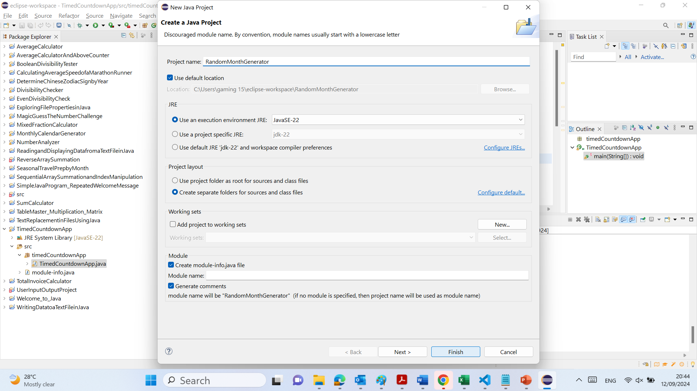

Slide 30
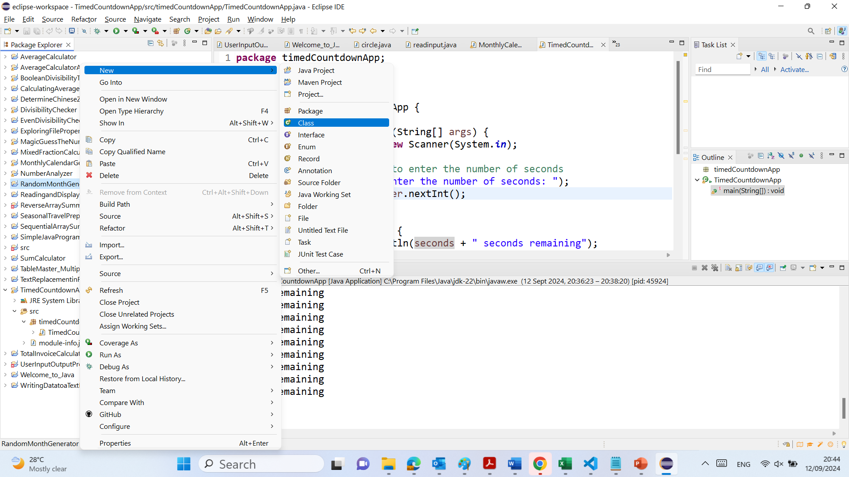

Slide 31
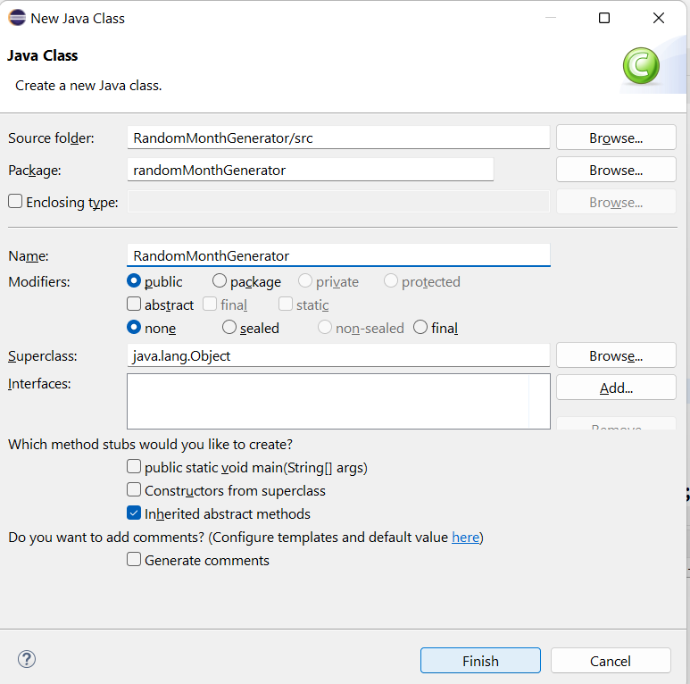

Slide 32
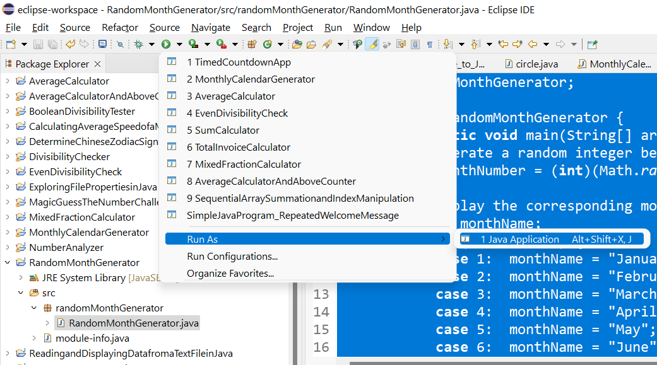

Slide 33
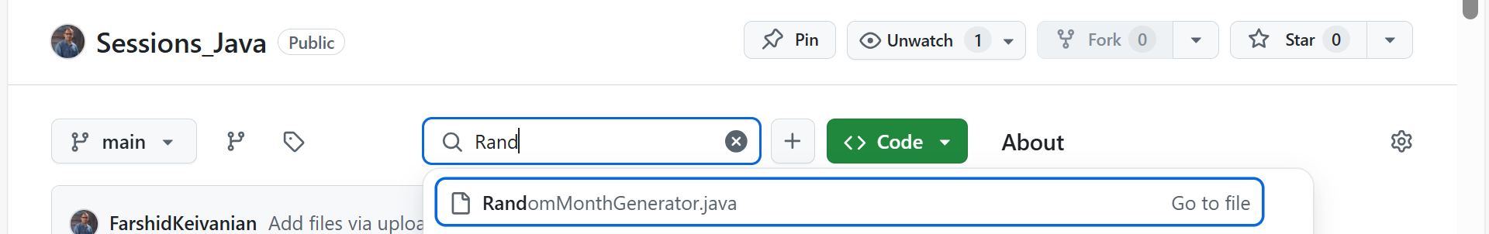
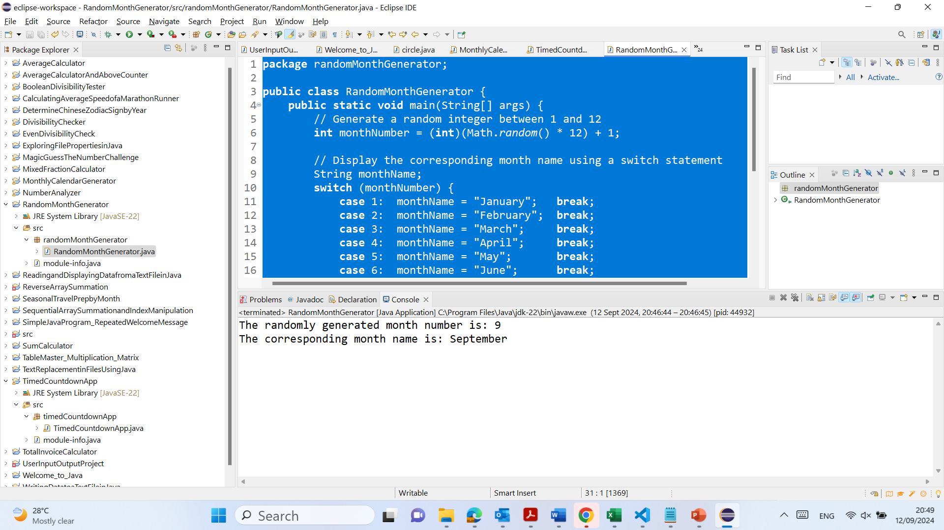

Slide 34
package randomMonthGenerator;
public class RandomMonthGenerator {
public static void main(String[] args) {
// Generate a random integer between 1 and 12
int monthNumber = (int)(Math.random() * 12) + 1;
// Display the corresponding month name using a switch statement
String monthName;
switch (monthNumber) {
case 1: monthName = "January"; break;
case 2: monthName = "February"; break;
case 3: monthName = "March"; break;
case 4: monthName = "April"; break;
case 5: monthName = "May"; break;
case 6: monthName = "June"; break;
case 7: monthName = "July"; break;
case 8: monthName = "August"; break;
case 9: monthName = "September"; break;
case 10: monthName = "October"; break;
case 11: monthName = "November"; break;
case 12: monthName = "December"; break;
default: monthName = "Invalid month"; break; // This should never occur
}
// Output the randomly generated month number and corresponding month name
System.out.println("The randomly generated month number is: " + monthNumber);
System.out.println("The corresponding month name is: " + monthName);
}
}
package randomMonthGenerator;
Organizes the class in the randomMonthGenerator package.
public class RandomMonthGenerator {
Declares the main class RandomMonthGenerator.

Slide 35
package randomMonthGenerator;
public class RandomMonthGenerator {
public static void main(String[] args) {
// Generate a random integer between 1 and 12
int monthNumber = (int)(Math.random() * 12) + 1;
// Display the corresponding month name using a switch statement
String monthName;
switch (monthNumber) {
case 1: monthName = "January"; break;
case 2: monthName = "February"; break;
case 3: monthName = "March"; break;
case 4: monthName = "April"; break;
case 5: monthName = "May"; break;
case 6: monthName = "June"; break;
case 7: monthName = "July"; break;
case 8: monthName = "August"; break;
case 9: monthName = "September"; break;
case 10: monthName = "October"; break;
case 11: monthName = "November"; break;
case 12: monthName = "December"; break;
default: monthName = "Invalid month"; break; // This should never occur
}
// Output the randomly generated month number and corresponding month name
System.out.println("The randomly generated month number is: " + monthNumber);
System.out.println("The corresponding month name is: " + monthName);
}
}
public static void main(String[] args) {
The entry point of the program where execution begins.
int monthNumber = (int)(Math.random() * 12) + 1;
Generates a random integer between 1 and 12 to represent a month.

Slide 36
package randomMonthGenerator;
public class RandomMonthGenerator {
public static void main(String[] args) {
// Generate a random integer between 1 and 12
int monthNumber = (int)(Math.random() * 12) + 1;
// Display the corresponding month name using a switch statement
String monthName;
switch (monthNumber) {
case 1: monthName = "January"; break;
case 2: monthName = "February"; break;
case 3: monthName = "March"; break;
case 4: monthName = "April"; break;
case 5: monthName = "May"; break;
case 6: monthName = "June"; break;
case 7: monthName = "July"; break;
case 8: monthName = "August"; break;
case 9: monthName = "September"; break;
case 10: monthName = "October"; break;
case 11: monthName = "November"; break;
case 12: monthName = "December"; break;
default: monthName = "Invalid month"; break; // This should never occur
}
// Output the randomly generated month number and corresponding month name
System.out.println("The randomly generated month number is: " + monthNumber);
System.out.println("The corresponding month name is: " + monthName);
}
}
String monthName;
Declares a variable to store the month name corresponding to monthNumber.
switch (monthNumber) { ... }
Matches monthNumber to a month name using a switch statement.
case X: monthName = "MonthName"; break;
Assigns the correct month name to monthName based on monthNumber.

Slide 37
package randomMonthGenerator;
public class RandomMonthGenerator {
public static void main(String[] args) {
// Generate a random integer between 1 and 12
int monthNumber = (int)(Math.random() * 12) + 1;
// Display the corresponding month name using a switch statement
String monthName;
switch (monthNumber) {
case 1: monthName = "January"; break;
case 2: monthName = "February"; break;
case 3: monthName = "March"; break;
case 4: monthName = "April"; break;
case 5: monthName = "May"; break;
case 6: monthName = "June"; break;
case 7: monthName = "July"; break;
case 8: monthName = "August"; break;
case 9: monthName = "September"; break;
case 10: monthName = "October"; break;
case 11: monthName = "November"; break;
case 12: monthName = "December"; break;
default: monthName = "Invalid month"; break; // This should never occur
}
// Output the randomly generated month number and corresponding month name
System.out.println("The randomly generated month number is: " + monthNumber);
System.out.println("The corresponding month name is: " + monthName);
}
}
default: monthName = "Invalid month"; break;
Handles any unexpected values (though this shouldn’t occur).
System.out.println("The randomly generated month number is: " + monthNumber);
Prints the generated month number.

Slide 38
package randomMonthGenerator;
public class RandomMonthGenerator {
public static void main(String[] args) {
// Generate a random integer between 1 and 12
int monthNumber = (int)(Math.random() * 12) + 1;
// Display the corresponding month name using a switch statement
String monthName;
switch (monthNumber) {
case 1: monthName = "January"; break;
case 2: monthName = "February"; break;
case 3: monthName = "March"; break;
case 4: monthName = "April"; break;
case 5: monthName = "May"; break;
case 6: monthName = "June"; break;
case 7: monthName = "July"; break;
case 8: monthName = "August"; break;
case 9: monthName = "September"; break;
case 10: monthName = "October"; break;
case 11: monthName = "November"; break;
case 12: monthName = "December"; break;
default: monthName = "Invalid month"; break; // This should never occur
}
// Output the randomly generated month number and corresponding month name
System.out.println("The randomly generated month number is: " + monthNumber);
System.out.println("The corresponding month name is: " + monthName);
}
}
System.out.println("The corresponding month name is: " + monthName);
Prints the corresponding month name.

Slide 39
6.3 (1%) (Basic Strings Exercises) Write a program to perform the following string operations.
Hint: check out the ‘Lecture 4 Slides - Program constructs’ and the String class methods in Java API.
• Combine string "north" and string "sydney" to display "NORTH SYDNEY". Note that the result must have a space between "NORTH" and "SYDNEY".
• Then the program displays the string length and its last character.
• Finally, the program changes the string to "NORTH SHORE" and displays it to the console.

Slide 40
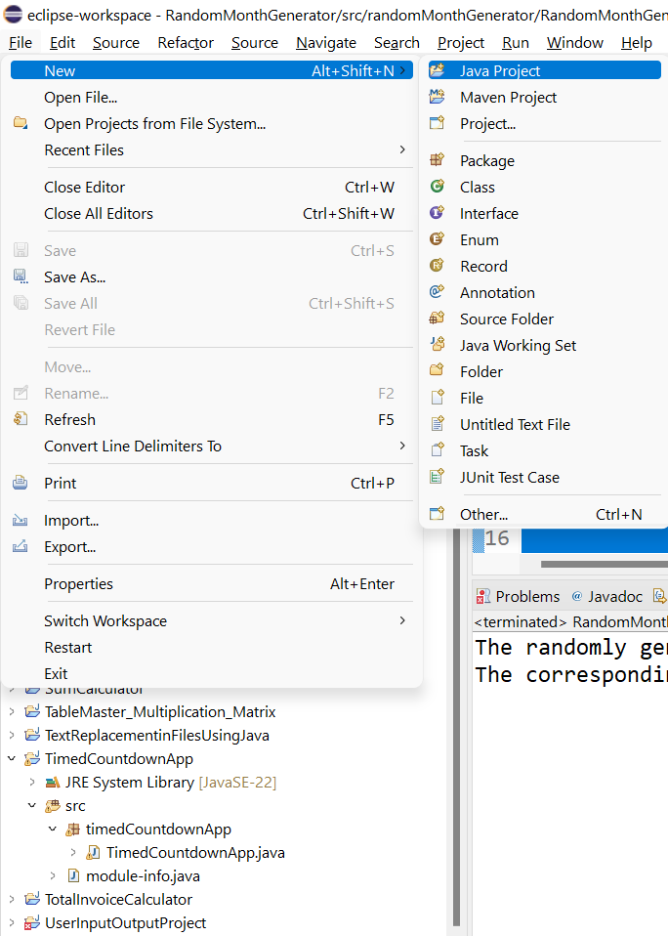

Slide 41
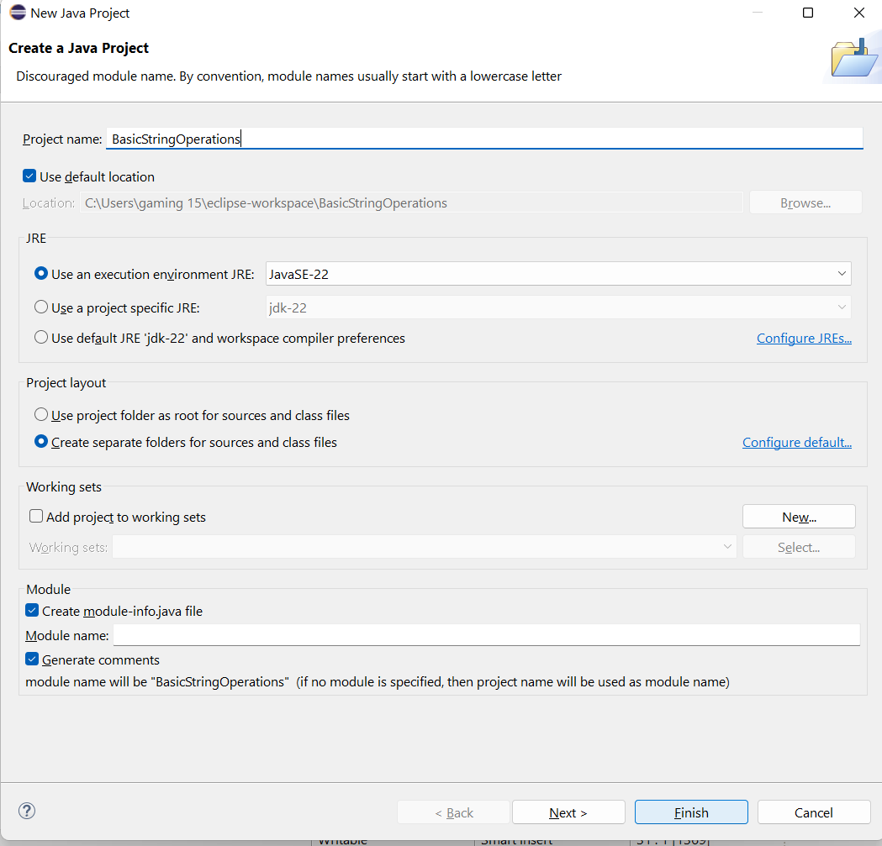

Slide 42
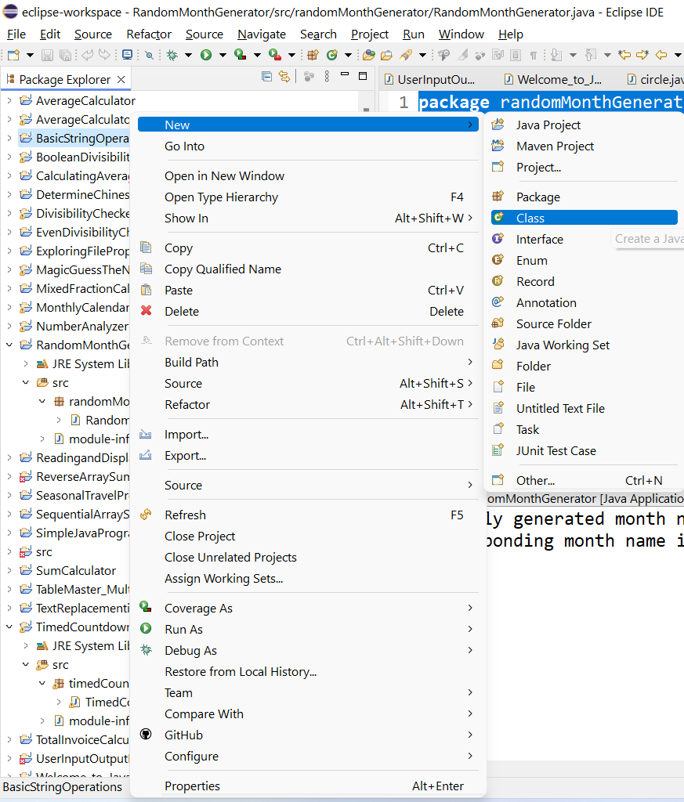

Slide 43
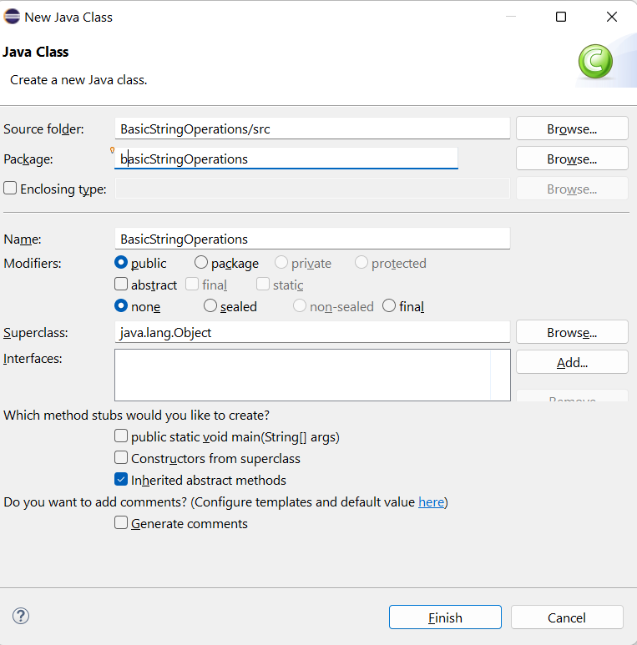

Slide 44
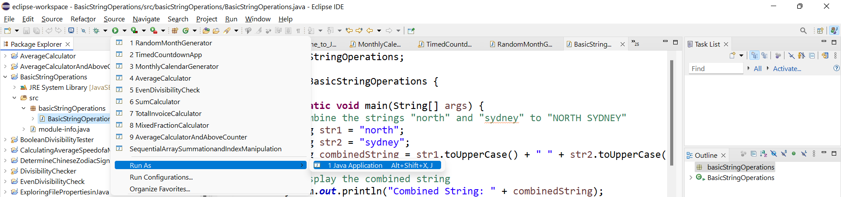
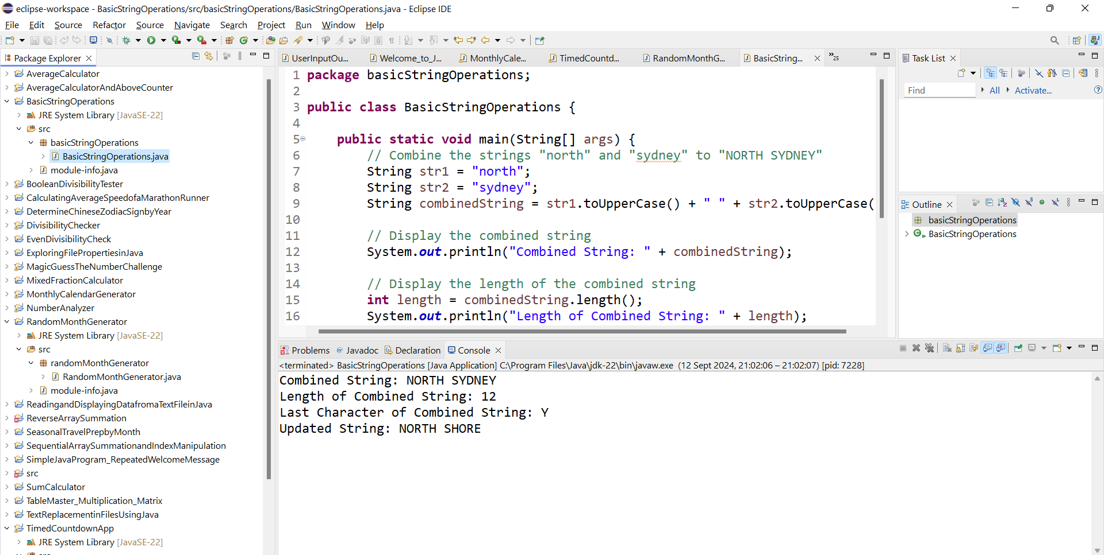

Slide 45
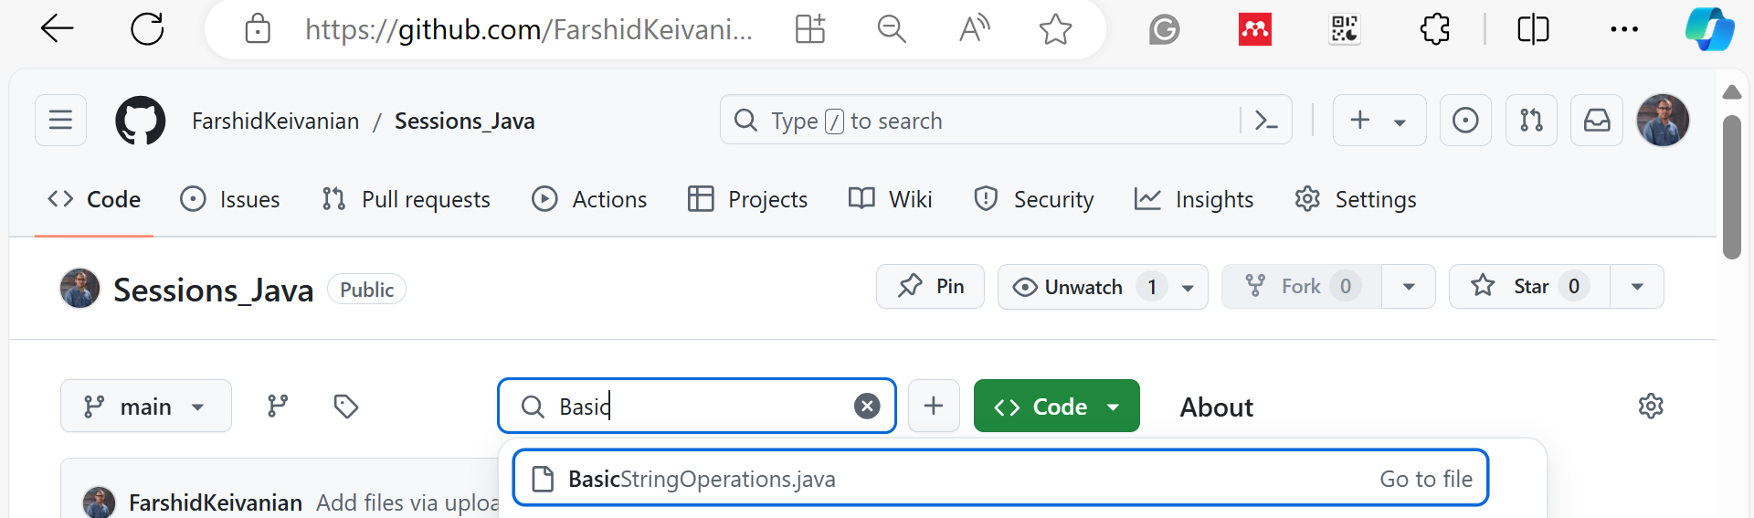

Slide 46
package basicStringOperations;
public class BasicStringOperations {
public static void main(String[] args) {
// Combine the strings "north" and "sydney" to "NORTH SYDNEY"
String str1 = "north";
String str2 = "sydney";
String combinedString = str1.toUpperCase() + " " + str2.toUpperCase();
// Display the combined string
System.out.println("Combined String: " + combinedString);
// Display the length of the combined string
int length = combinedString.length();
System.out.println("Length of Combined String: " + length);
// Display the last character of the combined string
char lastChar = combinedString.charAt(length - 1);
System.out.println("Last Character of Combined String: " + lastChar);
// Change the string to "NORTH SHORE" and display it
combinedString = "NORTH SHORE";
System.out.println("Updated String: " + combinedString);
}
}
package basicStringOperations;
Defines the package basicStringOperations for organizing the class.
public class BasicStringOperations {
Declares the BasicStringOperations class.

Slide 47
package basicStringOperations;
public class BasicStringOperations {
public static void main(String[] args) {
// Combine the strings "north" and "sydney" to "NORTH SYDNEY"
String str1 = "north";
String str2 = "sydney";
String combinedString = str1.toUpperCase() + " " + str2.toUpperCase();
// Display the combined string
System.out.println("Combined String: " + combinedString);
// Display the length of the combined string
int length = combinedString.length();
System.out.println("Length of Combined String: " + length);
// Display the last character of the combined string
char lastChar = combinedString.charAt(length - 1);
System.out.println("Last Character of Combined String: " + lastChar);
// Change the string to "NORTH SHORE" and display it
combinedString = "NORTH SHORE";
System.out.println("Updated String: " + combinedString);
}
}
public static void main(String[] args) {
The main method where program execution starts.
String str1 = "north";
Initializes the first string as "north".

Slide 48
package basicStringOperations;
public class BasicStringOperations {
public static void main(String[] args) {
// Combine the strings "north" and "sydney" to "NORTH SYDNEY"
String str1 = "north";
String str2 = "sydney";
String combinedString = str1.toUpperCase() + " " + str2.toUpperCase();
// Display the combined string
System.out.println("Combined String: " + combinedString);
// Display the length of the combined string
int length = combinedString.length();
System.out.println("Length of Combined String: " + length);
// Display the last character of the combined string
char lastChar = combinedString.charAt(length - 1);
System.out.println("Last Character of Combined String: " + lastChar);
// Change the string to "NORTH SHORE" and display it
combinedString = "NORTH SHORE";
System.out.println("Updated String: " + combinedString);
}
}
String str2 = "sydney";
Initializes the second string as "sydney".
String combinedString = str1.toUpperCase() + " " + str2.toUpperCase();
Combines str1 and str2 in uppercase with a space in between, resulting in "NORTH SYDNEY".

Slide 49
package basicStringOperations;
public class BasicStringOperations {
public static void main(String[] args) {
// Combine the strings "north" and "sydney" to "NORTH SYDNEY"
String str1 = "north";
String str2 = "sydney";
String combinedString = str1.toUpperCase() + " " + str2.toUpperCase();
// Display the combined string
System.out.println("Combined String: " + combinedString);
// Display the length of the combined string
int length = combinedString.length();
System.out.println("Length of Combined String: " + length);
// Display the last character of the combined string
char lastChar = combinedString.charAt(length - 1);
System.out.println("Last Character of Combined String: " + lastChar);
// Change the string to "NORTH SHORE" and display it
combinedString = "NORTH SHORE";
System.out.println("Updated String: " + combinedString);
}
}
System.out.println("Combined String: " + combinedString);
Prints the combined string "NORTH SYDNEY".
int length = combinedString.length();
Calculates the length of the combined string.

Slide 50
package basicStringOperations;
public class BasicStringOperations {
public static void main(String[] args) {
// Combine the strings "north" and "sydney" to "NORTH SYDNEY"
String str1 = "north";
String str2 = "sydney";
String combinedString = str1.toUpperCase() + " " + str2.toUpperCase();
// Display the combined string
System.out.println("Combined String: " + combinedString);
// Display the length of the combined string
int length = combinedString.length();
System.out.println("Length of Combined String: " + length);
// Display the last character of the combined string
char lastChar = combinedString.charAt(length - 1);
System.out.println("Last Character of Combined String: " + lastChar);
// Change the string to "NORTH SHORE" and display it
combinedString = "NORTH SHORE";
System.out.println("Updated String: " + combinedString);
}
}
System.out.println("Length of Combined String: " + length);
Displays the length of the combined string.
char lastChar = combinedString.charAt(length - 1);
Retrieves the last character of the combined string.

Slide 51
package basicStringOperations;
public class BasicStringOperations {
public static void main(String[] args) {
// Combine the strings "north" and "sydney" to "NORTH SYDNEY"
String str1 = "north";
String str2 = "sydney";
String combinedString = str1.toUpperCase() + " " + str2.toUpperCase();
// Display the combined string
System.out.println("Combined String: " + combinedString);
// Display the length of the combined string
int length = combinedString.length();
System.out.println("Length of Combined String: " + length);
// Display the last character of the combined string
char lastChar = combinedString.charAt(length - 1);
System.out.println("Last Character of Combined String: " + lastChar);
// Change the string to "NORTH SHORE" and display it
combinedString = "NORTH SHORE";
System.out.println("Updated String: " + combinedString);
}
}
System.out.println("Last Character of Combined String: " + lastChar);
Prints the last character of the combined string.
combinedString = "NORTH SHORE";
Updates the string to "NORTH SHORE".
System.out.println("Updated String: " + combinedString);
Prints the updated string "NORTH SHORE".

Slide 52
6.5 (1%) (Understanding the Code)
Study and understand the above code by paying particular attention on how the readAndComputeAvgCost() method gets use of the subroutine calculation methods getTotal() and getAverage(). Find a bug in the above program and explain to your lab tutor. Hint: the bug is a logic error.

Slide 53
6.5 (1%) (Understanding the Code)
Explanation and Bug Identification:
The provided code snippet defines a program that calculates the total and average cost of shopping items. The readAndComputeAvgCost() method calls two subroutine methods: getTotal() and getAverage().
Functions Overview:
getTotal(double uPrice, double qty, double totalAmt):
It returns the sum of totalAmt and the product of uPrice and qty.
getAverage(double total, int count):
It calculates the average cost by dividing the total amount by the number of items (count).

Slide 54
6.5 (1%) (Understanding the Code)
Potential Bug (Logic Error):
The logic error is in the getTotal() method:
Current Implementation:
public static double getTotal(double uPrice, double qty, double totalAmt) {
return totalAmt + uPrice * qty;
}

Slide 55
6.5 (1%) (Understanding the Code)
public static double getTotal(double uPrice, double qty, double totalAmt) {
return totalAmt + uPrice * qty;
}
Issue: Every time the getTotal() method is called within the loop in the readAndComputeAvgCost() method, it returns the cumulative total. However, this cumulative total is incorrectly calculated because the totalAmt parameter passed to getTotal() includes the running total, which is then incorrectly added again to the new total.
Impact: This logic leads to an incorrect and inflated total amount, which in turn affects the average calculation.

Slide 56
6.5 (1%) (Understanding the Code)
Corrected Implementation:
The getTotal() method should be simplified to only calculate the current cost for each iteration and then add it to the running total in the calling method (readAndComputeAvgCost()):
public static double getTotal(double uPrice, double qty) {
return uPrice * qty;
}

Slide 57
6.5 (1%) (Understanding the Code)
And the call to getTotal() inside the loop should be updated to:
total += getTotal(unitPrice, quantity);

Slide 58
Corrected Code:
import javax.swing.JOptionPane;
public class Test {
public static void main(String[] args) {
readAndComputeAvgCost();
}
public static void readAndComputeAvgCost() {
double total = 0;
int count = Integer.parseInt(JOptionPane.showInputDialog(
"Enter number of shopping items to buy"));
for (int i = 1; i <= count; i++) {
double unitPrice = Double.parseDouble(JOptionPane.showInputDialog(
"Enter unit price of a shopping item"));
double quantity = Double.parseDouble(JOptionPane.showInputDialog(
"Enter quantity required"));
total += getTotal(unitPrice, quantity);
}
System.out.format("The average cost is %.3f", getAverage(total, count));
}
public static double getTotal(double uPrice, double qty) {
return uPrice * qty;
}
public static double getAverage(double total, int count) {
return total / count;
}
}

Slide 59
The original code had a logic error in the getTotal() method where the running total (totalAmt) was being incorrectly passed and added to itself. This resulted in an inflated total, leading to an incorrect average calculation. The corrected approach simplifies the getTotal() method to only return the product of the unit price and quantity, which is then correctly accumulated in the readAndComputeAvgCost() method.

Slide 60
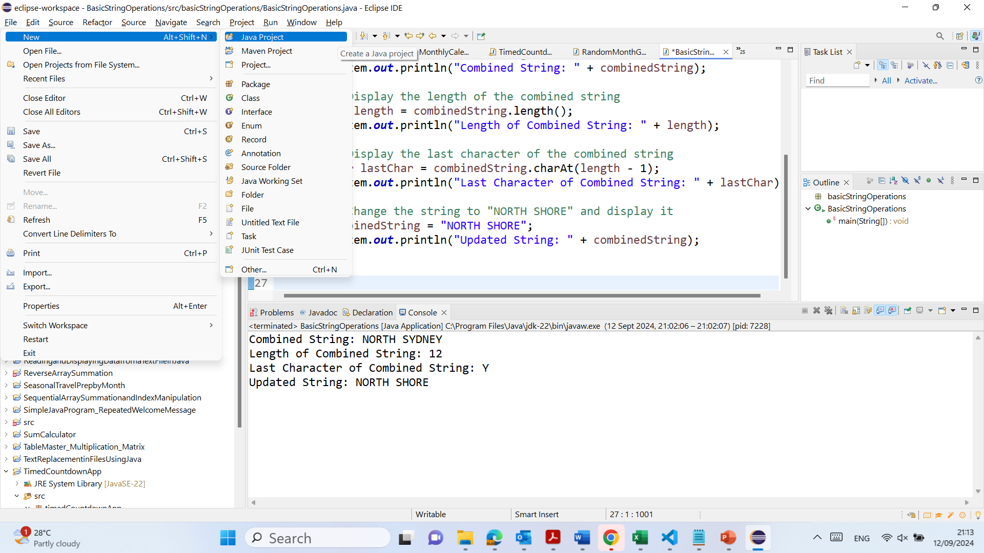

Slide 61
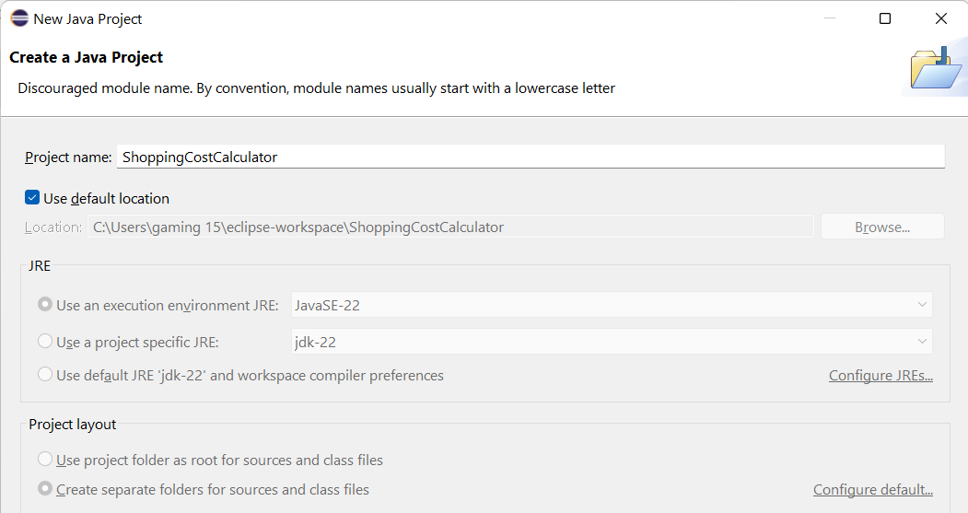

Slide 62
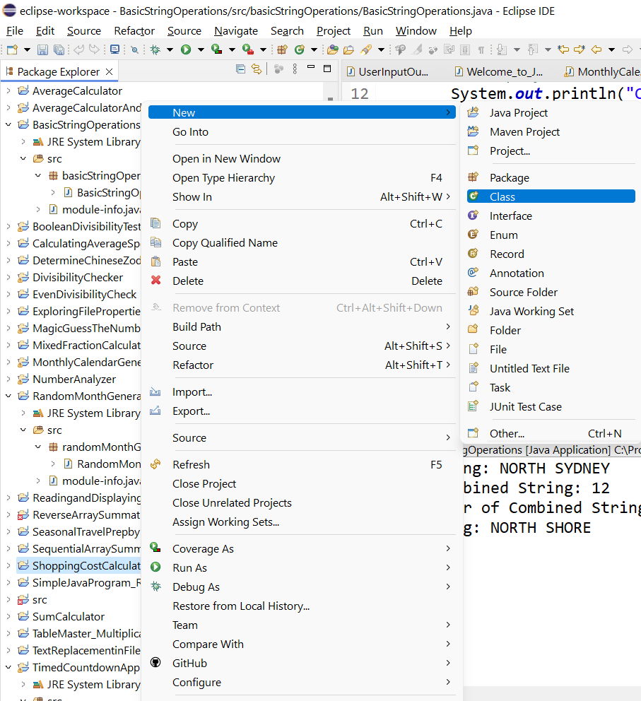

Slide 63
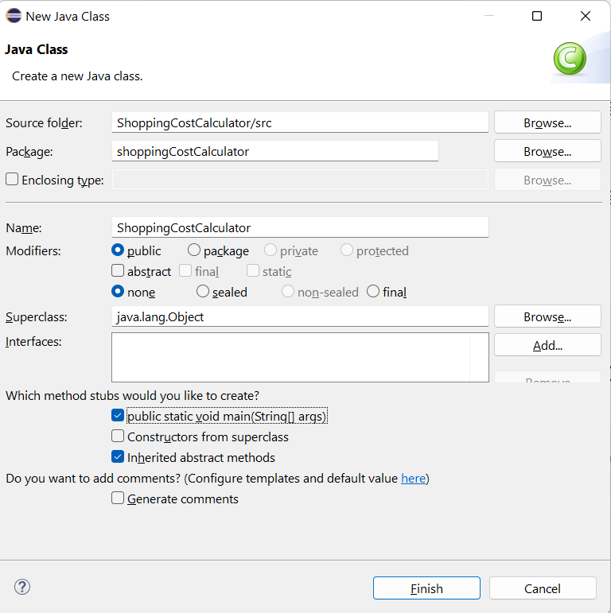

Slide 64
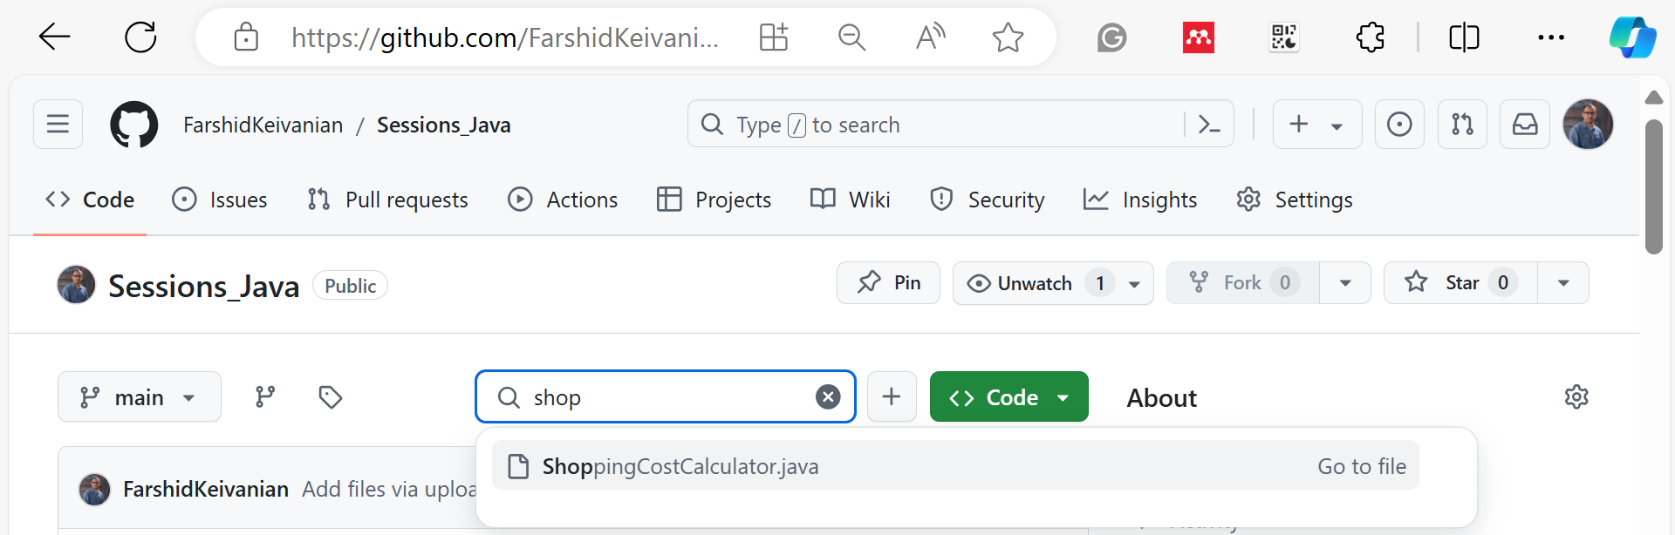

Slide 65
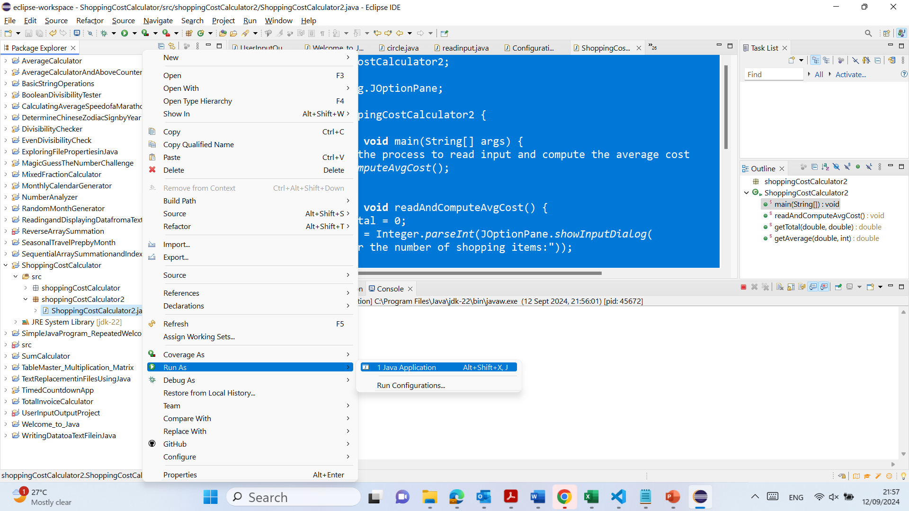

Slide 66
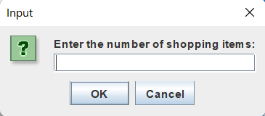
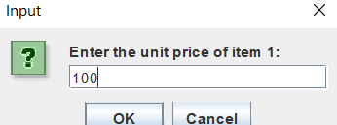

Slide 67
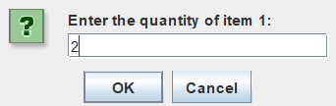
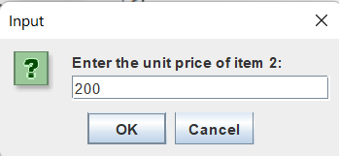

Slide 68
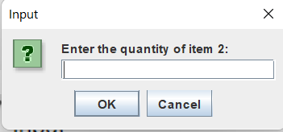
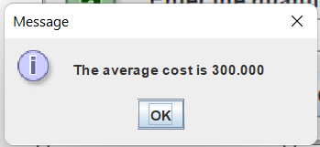

Slide 69
package shoppingCostCalculator2;
import javax.swing.JOptionPane;
public class ShoppingCostCalculator2 {
public static void main(String[] args) {
// Start the process to read input and compute the average cost
readAndComputeAvgCost();
}
public static void readAndComputeAvgCost() {
double total = 0;
int count = Integer.parseInt(JOptionPane.showInputDialog(
"Enter the number of shopping items:"));
for (int i = 1; i <= count; i++) {
double unitPrice = Double.parseDouble(JOptionPane.showInputDialog(
"Enter the unit price of item " + i + ":"));
double quantity = Double.parseDouble(JOptionPane.showInputDialog(
"Enter the quantity of item " + i + ":"));
total += getTotal(unitPrice, quantity);
}
double averageCost = getAverage(total, count);
JOptionPane.showMessageDialog(null, String.format("The average cost is %.3f", averageCost));
}
public static double getTotal(double uPrice, double qty) {
return uPrice * qty;
}
public static double getAverage(double total, int count) {
return total / count;
}
}
This Java program calculates the average cost of shopping items. Here's a concise explanation:
Main Method: Initiates the process by calling readAndComputeAvgCost().

Slide 70
2. readAndComputeAvgCost Method:
Prompts the user to input the number of items.
For each item, asks for its unit price and quantity.
Calculates the total cost by summing the product of unit price and quantity for all items.
Computes the average cost by dividing the total cost by the number of items.
Displays the average cost using a message dialog.
package shoppingCostCalculator2;
import javax.swing.JOptionPane;
public class ShoppingCostCalculator2 {
public static void main(String[] args) {
// Start the process to read input and compute the average cost
readAndComputeAvgCost();
}
public static void readAndComputeAvgCost() {
double total = 0;
int count = Integer.parseInt(JOptionPane.showInputDialog(
"Enter the number of shopping items:"));
for (int i = 1; i <= count; i++) {
double unitPrice = Double.parseDouble(JOptionPane.showInputDialog(
"Enter the unit price of item " + i + ":"));
double quantity = Double.parseDouble(JOptionPane.showInputDialog(
"Enter the quantity of item " + i + ":"));
total += getTotal(unitPrice, quantity);
}
double averageCost = getAverage(total, count);
JOptionPane.showMessageDialog(null, String.format("The average cost is %.3f", averageCost));
}
public static double getTotal(double uPrice, double qty) {
return uPrice * qty;
}
public static double getAverage(double total, int count) {
return total / count;
}
}

Slide 71
3. getTotal Method: Multiplies unit price by quantity to find the cost of an item.
4. getAverage Method: Divides the total cost by the number of items to find the average cost.
package shoppingCostCalculator2;
import javax.swing.JOptionPane;
public class ShoppingCostCalculator2 {
public static void main(String[] args) {
// Start the process to read input and compute the average cost
readAndComputeAvgCost();
}
public static void readAndComputeAvgCost() {
double total = 0;
int count = Integer.parseInt(JOptionPane.showInputDialog(
"Enter the number of shopping items:"));
for (int i = 1; i <= count; i++) {
double unitPrice = Double.parseDouble(JOptionPane.showInputDialog(
"Enter the unit price of item " + i + ":"));
double quantity = Double.parseDouble(JOptionPane.showInputDialog(
"Enter the quantity of item " + i + ":"));
total += getTotal(unitPrice, quantity);
}
double averageCost = getAverage(total, count);
JOptionPane.showMessageDialog(null, String.format("The average cost is %.3f", averageCost));
}
public static double getTotal(double uPrice, double qty) {
return uPrice * qty;
}
public static double getAverage(double total, int count) {
return total / count;
}
}

